Slide 1


Noida Institute of Engineering and Technology, Greater Noida
Artificial Intelligence & Machine Learning
Unit: 3
Supervised Learning
Mohini Chakarverti
Assistant Professor
Department of CSE(AIML)
Course Details
B-Tech 3rd Sem. ONLINE & Offline

Slide 2

Faculty Introduction
Name | Mohini Chakarverti
Qualification | Ph.D.(Pursuing)
Designation | Assistant Professor
Department | CSE-AIML
NIET Experience | 3 Years
Subject Taught | Introduction to AI and ML,

Slide 3
Evaluation Scheme
 | Sl. No. | Subject Codes |  | Subject | Periods |  |  |  |  | Evaluation Schemes |  |  |  | End Sem |  | Total | Credit | Category Type
 |  |  |  |  | L |  | T | P |  | CT | TA | TOTAL | PS | TE | PE
 | 1 |  |  | Statistics & Probability | 3 |  | 1 | 0 |  | 30 | 20 | 50 |  | 100 |  | 150 | 4 | BSC
 | 2 |  |  | Discrete Structures | 3 |  | 1 | 0 |  | 30 | 20 | 50 |  | 100 |  | 150 | 4 | BSC
 | 3 |  |  | Artificial Intelligence & Machine Learning | 3 |  | 0 | 0 |  | 30 | 20 | 50 |  | 100 |  | 150 | 3 | PCC
 | 4 |  |  | Data Structures & Algorithm-I | 3 |  | 0 | 0 |  | 30 | 20 | 50 |  | 100 |  | 150 | 3 | PCC
 | 5 |  |  | Logic Design and Computer Architecture | 3 |  | 0 | 0 |  | 30 | 20 | 50 |  | 100 |  | 150 | 3 | PCC
 | 6 |  |  | Object Oriented Techniques using Java | 0 |  | 0 | 6 |  |  |  |  | 50 |  | 100 | 150 | 3 | PCC
 | 7 |  |  | Artificial Intelligence & Machine Learning Lab | 0 |  | 0 | 2 |  |  |  |  | 50 |  | 50 | 100 | 1 | PCC
 | 8 |  |  | Data Structures & Algorithm-I Lab | 0 |  | 0 | 4 |  |  |  |  | 25 |  | 25 | 50 | 2 | PCC
 | 9 |  |  | Internship Assessment- I | 0 |  | 0 | 2 |  |  |  |  | 50 |  |  | 50 | 1 | PW
 | 10 |  |  | AI & Cyber Ethics / Environmental Science *(Non Crédit) | 2 |  | 0 | 0 |  | 30 | 20 | 50 |  | 50 |  | 100 | 0 | NC
 |  |  |  | MOOCs (For B.Tech. Hons. Degree)
 |  |  |  | TOTAL |  |  |  |  |  |  |  |  |  |  |  | 1100 | 24

Slide 4

Syllabus
UNIT-1 Introduction to AI and Machine Learning
Introduction to AI and Intelligent agent, Different Approaches of AI,
Problem Solving by searching Techniques:
Uninformed search- BFS, DFS, Iterative deepening, Bidirectional search,
Informed search- Iterative deepening, Bidirectional search, Heuristic search, Greedy Best First Search, A* search, Local Search Algorithms-Hill Climbing and Simulated Annealing Adversarial Search-
Game Playing- minimax, alpha-beta pruning,
constraint satisfaction problems

Slide 5
Syllabus
UNIT-2 Machine Learning & Feature Engineering
Introduction to Machine Learning, Types of Machine Learning,
Feature Engineering: Features and their types, handing missing data,
Dealing with categorical features,
Working with features: Feature Scaling, Feature selection,
Feature Extraction: Principal Component Analysis (PCA) algorithm

Slide 6
Syllabus
UNIT-3 Supervised Learning
Regression & Classification: Types of regression (Univariate, Multivariate, Polynomial), Mean Square Error, R square error,
Logistic Regression
Regularization: Bias and Variance, Overfitting and Underfitting, L1 and L2 Regularization, Regularized Linear Regression
Decision Trees (ID3, C4.5, CART), Confusion matrix, k-folds cross-validation,
K Nearest Neighbour, Support vector machine

Slide 7
Syllabus
UNIT-4 Unsupervised Machine Learning
Introduction to clustering, Types of clustering:
K-means clustering, K-mode, K-medoid, hierarchical clustering, single-linkage, multiple linkage, AGNES and DIANA algorithms, Gaussian mixture models
density based clustering, DBSCAN

Slide 8
Syllabus
UNIT-5 Ensemble & Reinforcement Learning
Probabilistic learning
:Bayesian Learning, Naive Bayes Classifier, Bayesian belief networks
Ensembles Learning
Random Forest, Gradient Boosting, XGBoost.
Reinforcement Learning:
Introduction to reinforcement learning, models of reinforcement learning: Markov decision process, Q-learning.

Slide 9
Branch Wise Applications
Maps and Navigation
Computer Vision
Facial Detection and Recognition
Text Editors or Autocorrect
Search and Recommendation Algorithms
Chatbots
Digital Assistants
Social Media
E-Payments
Digital Advertising

Slide 10
Course Objectives
The objective of this course is to systematically formulate and design machine learning problems for various applications, apply artificial intelligence algorithms and problem-solving methods to real-world scenarios, optimize the resulting models, and report on their expected accuracy.

Slide 11
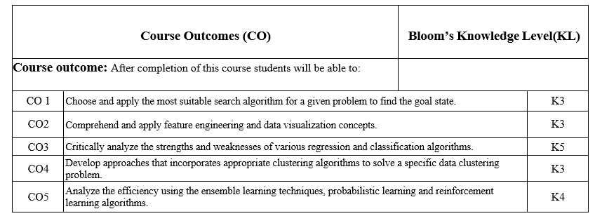
Course Outcomes

Slide 12
Program Outcomes
Engineering Graduates will be able to:
PO1 : Engineering Knowledge
PO2 : Problem Analysis
PO3 : Design/Development of solutions
PO4 : Conduct Investigations of complex problems
PO5 : Modern tool usage
PO6 : The engineer and society

Slide 13
Program Outcomes
Engineering Graduates will be able to:
PO7 : Environment and sustainability
PO8 : Ethics
PO9 : Individual and teamwork
PO10 : Communication
PO11 : Project management and finance
PO12 : Life-long learning

Slide 14
Program Specific Outcomes
On successful completion of graduation degree the Computer Science &
Engineering graduates will be able to:
PSO1: | Design and develop the Hardware and Software systems.
PSO2: | Understand the interdisciplinary computing techniques and an ability to apply them in the design of advanced computing.
PSO3: | Understand the programming methodology, software development paradigms, design and analysis of Algorithms, Operating Systems, Digital Logic Design, Theory of Computation, Discrete Mathematics, Compiler Design, etc.
PSO4: | To integrate & manage the various phases/components of software development projects of society.

Slide 15
Program Educational Objectives
Program Educational Objectives (PEOs) | PEOs Description
PEOs | To have an excellent scientific and engineering breadth so as to comprehend, analyze, design and provide sustainable solutions for real-life problems using state-of-the-art technologies.
PEOs | To have a successful career in industries, to pursue higher studies or to support entrepreneurial endeavors and to face the global challenges.
PEOs | To have an effective communication skills, professional attitude, ethical values and a desire to learn specific knowledge in emerging trends, technologies for research, innovation and product development and contribution to society.
PEOs | To have life-long learning for up-skilling and re-skilling for successful professional career as engineer, scientist, entrepreneur and bureaucrat for betterment of society.

Slide 16
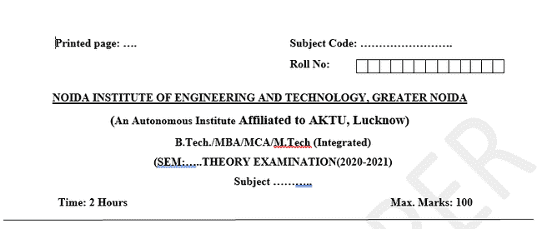
Question Paper Template

Slide 17
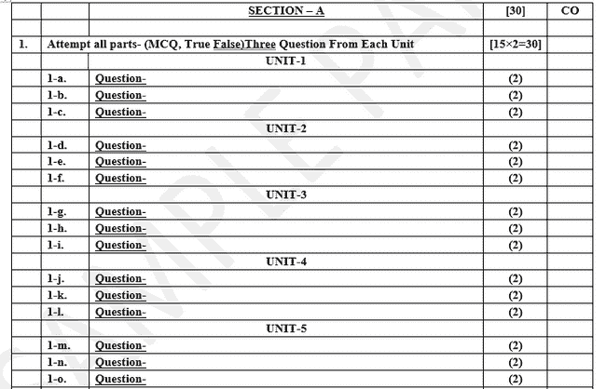
Question Paper Template

Slide 18
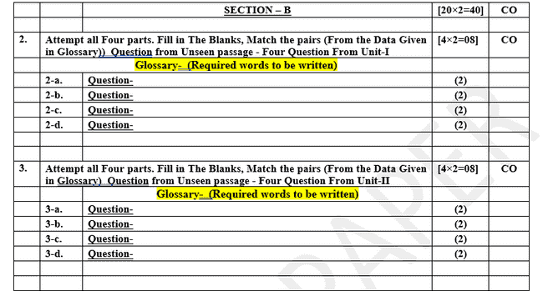
Question Paper Template

Slide 19
Question Paper Template

Slide 20
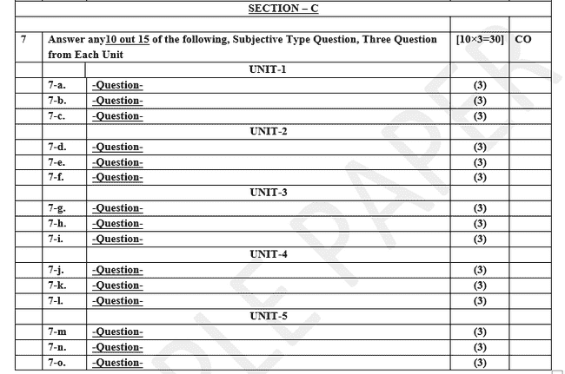
Question Paper Template

Slide 21
PREREQUISITE
Prerequisites:
Statistics.
Linear Algebra.
Calculus.
Probability.
Programming Languages.

Slide 22
Unit Content
Introduction to Machine Learning,
Types of Machine Learning,
Feature Engineering: Features and their types,
handing missing data,
Dealing with categorical features,
Working with features: Feature Scaling,
Feature selection,
Feature Extraction: Principal Component Analysis (PCA) algorithm

Slide 23

Introduction to Machine Learning
Top minds in machine learning predict where AI is going in 2021 and Beyond
AI is no longer poised to change the world someday; it’s changing the world now.

Slide 24
Course Outcomes (CO)
Course Outcomes (CO) |  | Bloom’s Knowledge Level (KL)
Course outcome: After completion of this course students will be able to:
CO 1 | Choose and apply the most suitable search algorithm for a given problem to find the goal state. |  | K3
CO2 | Comprehend and apply feature engineering and data visualization concepts. |  | K3
CO3 | Critically analyze the strengths and weaknesses of various regression and classification algorithms. |  | K5
CO4 | Develop approaches that incorporates appropriate clustering algorithms to solve a specific data clustering problem. |  | K3
CO5 | Analyze the efficiency using the ensemble learning techniques, probabilistic learning and reinforcement learning algorithms. |  | K4

Slide 25
Syllabus
Unit | Module | Lectures
Unit-I | Introduction to AI and problem-solving methods Introduction to AI and Intelligent agent, Different Approaches of AI, Problem Solving by searching Techniques: Uninformed search- BFS, DFS, Iterative deepening, Bi directional search, Informed search- Iterative deepening, Bi directional search, Heuristic search, Greedy Best First Search, A* search, Local Search Algorithms- Hill Climbing and Simulated Annealing Adversial Search- Game Playing- minimax, alpha-beta pruning, constraint satisfaction problems
Unit-II | Machine Learning & Feature Engineering Introduction to Machine Learning, Types of Machine Learning, Feature Engineering: Features and their types, handing missing data, Dealing with categorical features, Working with features: Feature Scaling, Feature selection, Feature Extraction: Principal Component Analysis (PCA) algorithm
Unit III | Supervised Learning Regression & Classification: Types of regression (Univariate, Multivariate, Polynomial), Mean Square Error, R square error, Logistic Regression, Regularization: Bias and Variance, Overfitting and Underfitting, L1 and L2 Regularization, Regularized Linear Regression, Decision Trees (ID3, C4.5, CART), Confusion matrix, k-folds cross-validation, K Nearest Neighbour, Support vector machine.
Unit IV | Unsupervised Machine Learning Introduction to clustering, Types of clustering: K-means clustering, K-mode, K-medoid, hierarchical clustering, single-linkage, multiple linkage, AGNES and DIANA algorithms, Gaussian mixture models density based clustering, DBSCAN
Unit V | Ensemble & Reinforcement Learning Probabilistic learning: Bayesian Learning, Naive Bayes Classifier, Bayesian belief networks, Ensembles Learning: Random Forest, Gradient Boosting, XGBoost., Reinforcement Learning: Introduction to reinforcement learning, models of reinforcement learning: Markov decision process, Q-learning.

Slide 26
Course Contents / Syllabus
UNIT-III | Supervised Learning | 8 Hours
Regression & Classification: Types of regression (Univariate, Multivariate, Polynomial), Mean Square Error, R square error, Logistic Regression, Regularization: Bias and Variance, Overfitting and Underfitting, L1 and L2 Regularization, Regularized Linear Regression, Decision Trees (ID3, C4.5, CART), Confusion matrix, k-folds cross-validation, K Nearest Neighbour, Support vector machine.

Slide 27
Regression
Regression is a supervised learning technique which helps in finding the correlation between variables and enables us to predict the continuous output variable based on the one or more predictor variables.
Regression refers to a type of predictive modeling technique used to estimate the relationships among variables.
It involves predicting a continuous outcome variable based on one or more predictor variables (features).
It is a statistical method to model the relationship between a dependent (target) and independent (predictor) variables with one or more independent variables.
It predicts continuous/real values such as temperature, age, salary, price, etc.
It is mainly used for prediction, forecasting, time series modeling, and determining the causal-effect relationship between variables.

Slide 28
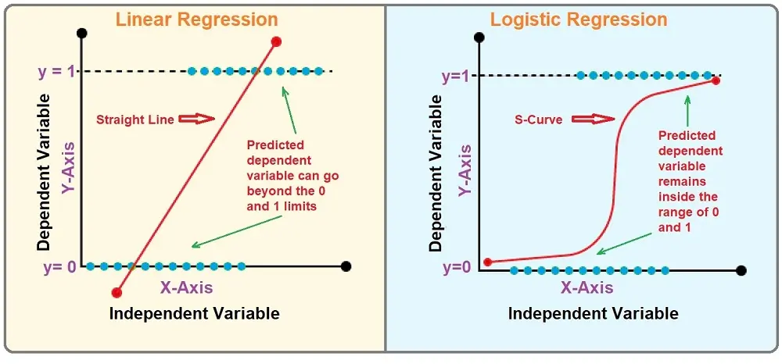
Regression
"Regression shows a line or curve that passes through all the datapoints on target-predictor graph in such a way that the vertical distance between the datapoints and the regression line is minimum."

Slide 29
Terminologies Related to the Regression Analysis
Dependent Variable: The main factor in Regression analysis which we want to predict or understand is called the dependent variable. It is also called target variable.
Independent Variable: The factors which affect the dependent variables or which are used to predict the values of the dependent variables are called independent variable, also called as a predictor.
Outliers: Outlier is an observation which contains either very low value or very high value in comparison to other observed values. An outlier may hamper the result, so it should be avoided.

Slide 30
Terminologies Related to the Regression Analysis
Multicollinearity: If the independent variables are highly correlated with each other than other variables, then such condition is called Multicollinearity. It should not be present in the dataset, because it creates problem while ranking the most affecting variable.
Underfitting and Overfitting: If our algorithm works well with the training dataset but not well with test dataset, then such problem is called Overfitting. And if our algorithm does not perform well even with training dataset, then such problem is called underfitting.

Slide 31
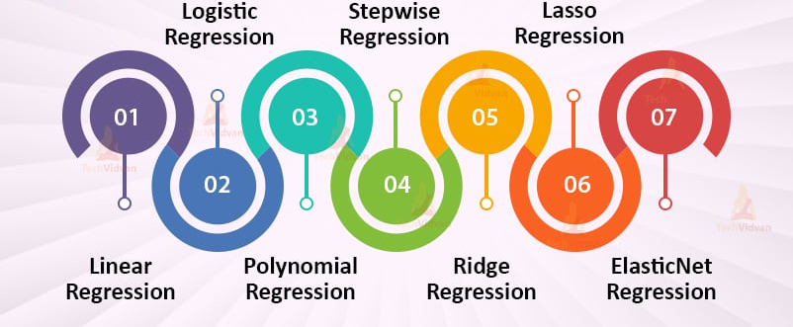
Types of Regression

Slide 32
Type of Regression: Univariate
Univariate regression refers to a statistical technique that analyzes the relationship between a single independent variable (predictor) and a single dependent variable (outcome). The goal is to model how changes in the independent variable affect the dependent variable.
Simple Linear Regression
Y=a+bX+ϵ
Use Case: Predicting outcomes like sales based on advertising spend
Polynomial Regression
Y=a+b₁ X+b₂ X²+b₃ X³+...+b_{n} X^{n} +ϵ
Use Case: Modeling relationships where the effect of the independent variable changes at different levels, such as growth patterns that are quadratic.

Slide 33
Type of Regression: Univariate
Logarithmic Regression
Y=a+blog(X)+ϵ
Use Case: Analyzing phenomena like the relationship between income and consumption, where increases in income lead to smaller increases in consumption.
Exponential Regression
Y=a⋅e ^{bX}
Use Case: Modeling population growth or radioactive decay.

Slide 34

Type of Regression:Multivariate regression
Multivariate regression involves the analysis of multiple independent variables to predict a single dependent variable.
Multiple Linear Regression
Y=a+b₁X₁+b₂X₂+...+b_{n}X_{n}+ϵ
Use Case: Predicting a person’s weight based on height, age, and exercise frequency.
Ridge Regression
where λ is the regularization parameter.
Use Case: Useful when there are many predictors, and you want to reduce model complexity.

Slide 35


Type of Regression:Multivariate regression
Lasso Regression
Use Case: Effective for variable selection in models with a large number of predictors.
Elastic Net Regression
Use Case: Useful when there are many correlated variables and you want a more robust model.

Slide 36
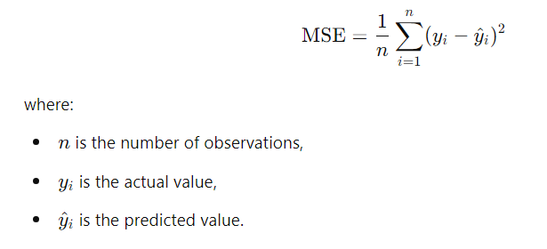
Mean Square Error (MSE)
Mean Squared Error (MSE) is a common metric used to evaluate the performance of regression models. It measures the average squared difference between the actual (observed) values and the predicted values generated by a model. The formula for MSE is:

Slide 37
Mean Square Error (MSE)
The Mean Squared Error (MSE) for this dataset is 0.6875. This value gives us an indication of how well the predicted values match the actual values, with a lower MSE representing better model performance.
Observation | Actual (y) | Predict (Y) | y - Y | (y-Y)^2
1 | 3 | 2.5 | 0.5 | 0.25
2 | -0.5 | 0 | -0.5 | 0.25
3 | 2 | 2 | 0 | 0
4 | 7 | 8.5 | -1.5 | 2.25
 |  |  | MSE | 0.6875

Slide 38
Importance of MSE
Performance Evaluation:
MSE provides a quantitative measure of how well a regression model predicts outcomes. A lower MSE indicates a better fit to the data, meaning the model's predictions are closer to the actual values.
Sensitivity to Outliers:
Since MSE squares the errors, it gives greater weight to larger errors. This sensitivity makes it effective for detecting models that may not perform well on extreme values, although it can also make the metric overly influenced by outliers.
Optimization Objective:
Many machine learning algorithms, particularly those based on gradient descent (e.g., linear regression, neural networks), use MSE as the loss function to minimize during training. By minimizing MSE, models learn to make better predictions.

Slide 39
Importance of MSE
Comparative Analysis:
MSE allows for easy comparison between different models or algorithms. By evaluating multiple models using MSE, practitioners can select the one with the best performance based on this metric.
Interpretable Metric:
Although MSE itself is in squared units of the target variable, it is straightforward to interpret. When paired with the square root (resulting in Root Mean Squared Error, RMSE), it can be expressed in the same units as the target variable, enhancing interpretability.

Slide 40
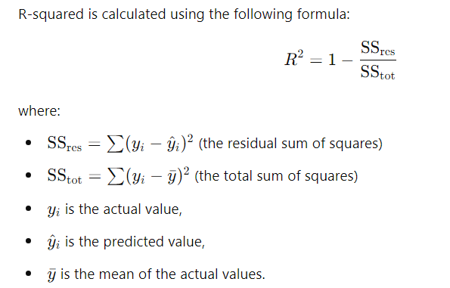
R-squared
R-squared, also known as the coefficient of determination, is a statistical measure that indicates how well the independent variables in a regression model explain the variability of the dependent variable.
It provides an indication of the goodness of fit of the model.

Slide 41
Interpretation of R-squared
Range: R-squared values range from 0 to 1.
0: Indicates that the model does not explain any variability in the dependent variable (the mean of the dependent variable is the best predictor).
1: Indicates that the model explains all the variability in the dependent variable (perfect prediction).
Value Interpretation:
An R² value of 0.70, for example, suggests that 70% of the variability in the dependent variable can be explained by the independent variables in the model, while 30% is attributed to other factors or random noise..

Slide 42
Linear Regression (Beyond The Syllabus)
Linear regression is a statistical regression method which is used for predictive analysis.
It is one of the very simple and easy algorithms which works on regression and shows the relationship between the continuous variables.
It is used for solving the regression problem in machine learning.
Linear regression shows the linear relationship between the independent variable (X-axis) and the dependent variable (Y-axis), hence called linear regression.
If there is only one input variable (x), then such linear regression is called simple linear regression. And if there is more than one input variable, then such linear regression is called multiple linear regression.
The relationship between variables in the linear regression model can be explained using the below image. Here we are predicting the salary of an employee on the basis of the year of experience.

Slide 43
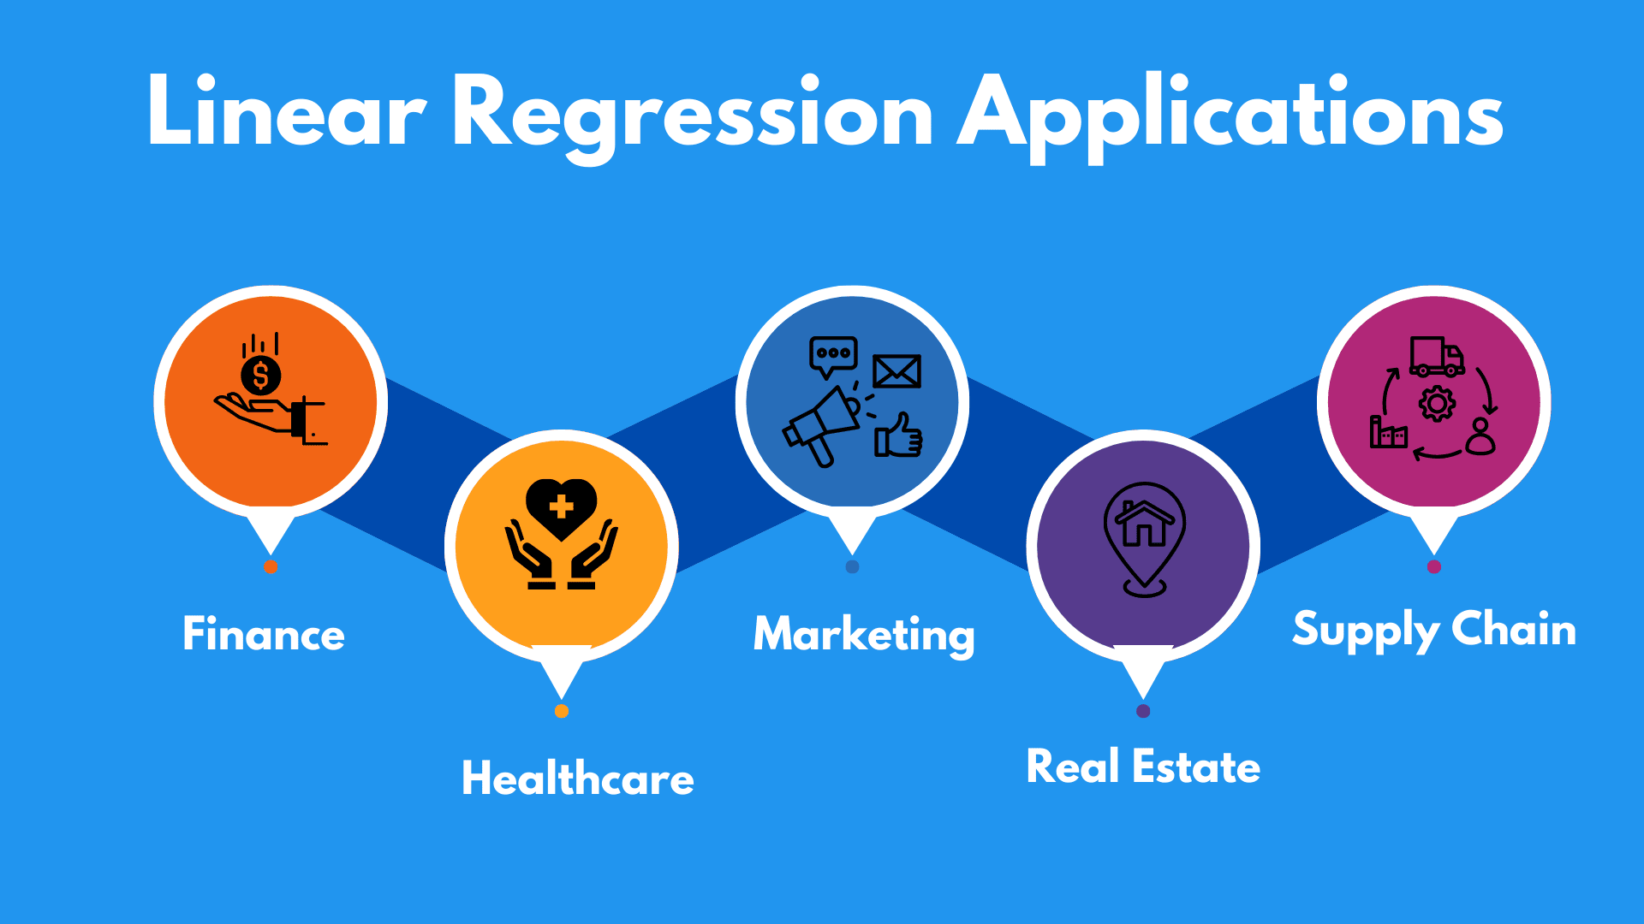
Linear Regression:
Some popular applications of linear regression are:
Analyzing trends and sales estimates
Salary forecasting
Real estate prediction
Arriving at ETAs in traffic.

Slide 44
Colab Link for Linear Regression:
https://colab.research.google.com/drive/1Ol5Rvfj-DDNR4vngO2EkZcfFaAM4jItw#scrollTo=0X7hGyLc11EZ

Slide 45
Logistic Regression:
Logistic regression is another supervised learning algorithm which is used to solve the classification problems.
In classification problems, we have dependent variables in a binary or discrete format such as 0 or 1.
Logistic regression algorithm works with the categorical variable such as 0 or 1, Yes or No, True or False, Spam or not spam, etc.
It is a predictive analysis algorithm which works on the concept of probability.
Logistic regression is a type of regression, but it is different from the linear regression algorithm in the term how they are used.
Logistic regression uses sigmoid function or logistic function which is a complex cost function.
This sigmoid function is used to model the data in logistic regression. The function can be represented as:

Slide 46
Logistic Regression:
Logistic regression is another supervised learning algorithm which is used to solve the classification problems.
In classification problems, we have dependent variables in a binary or discrete format such as 0 or 1.
Logistic regression algorithm works with the categorical variable such as 0 or 1, Yes or No, True or False, Spam or not spam, etc.
It is a predictive analysis algorithm which works on the concept of probability.
Logistic regression is a type of regression, but it is different from the linear regression algorithm in the term how they are used.
Logistic regression uses sigmoid function or logistic function which is a complex cost function.
This sigmoid function is used to model the data in logistic regression. The function can be represented as:

Slide 47
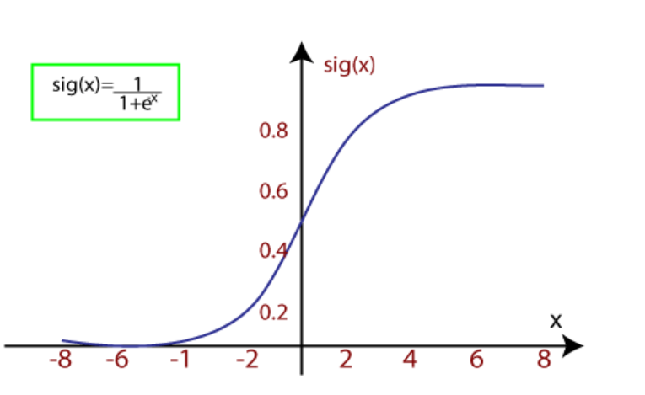
Logistic Regression:

Slide 48
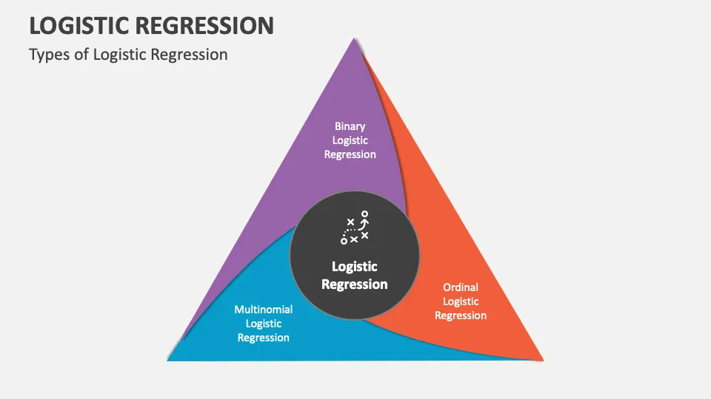
Types of Logistic Regression:
Binary(0/1, pass/fail)
Multi(cats, dogs, lions)
Ordinal(low, medium, high)

Slide 49
Binary logistic regression
Binary logistic regression predicts the relationship between the independent and binary dependent variables.
Some examples of the output of this regression type may be, success/failure, 0/1, or true/false.
Examples:
Deciding on whether or not to offer a loan to a bank customer: Outcome = yes or no.
Evaluating the risk of cancer: Outcome = high or low.
Predicting a team’s win in a football match: Outcome = yes or no.

Slide 50
Multinomial logistic regression
A categorical dependent variable has two or more discrete outcomes in a multinomial regression type. This implies that this regression type has more than two possible outcomes.
Examples:
Let’s say you want to predict the most popular transportation type for 2040. Here, transport type equates to the dependent variable, and the possible outcomes can be electric cars, electric trains, electric buses, and electric bikes.
Predicting whether a student will join a college, vocational/trade school, or corporate industry.
Estimating the type of food consumed by pets, the outcome may be wet food, dry food, or junk food.

Slide 51
Ordinal logistic regression
Ordinal logistic regression applies when the dependent variable is in an ordered state (i.e., ordinal).
The dependent variable (y) specifies an order with two or more categories or levels.
Examples: Dependent variables represent,
Formal shirt size: Outcomes = XS/S/M/L/XL
Survey answers: Outcomes = Agree/Disagree/Unsure
Scores on a math test: Outcomes = Poor/Average/Good

Slide 52
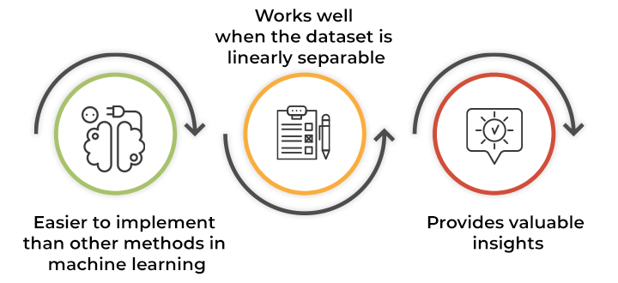
Key advantages of logistic regression

Slide 53
Colab Link for Linear Regression:
Case Study: Predicting Diabetes Using Logistic Regression
https://colab.research.google.com/drive/1QhRP1lhm05y6-I_T6uSz2CphiMcLKDYo#scrollTo=IHo9w80zCKoR

Slide 54
Regularization
Regularization is a technique used in machine learning and statistics to prevent overfitting, which occurs when a model learns the noise in the training data instead of the underlying patterns.
Purpose:
To improve model generalization and performance on unseen data by reducing overfitting.
Common Types:
L1 Regularization (Lasso): Adds a penalty equal to the absolute value of the coefficients. It can produce sparse models by driving some coefficients to zero, effectively selecting features.
L2 Regularization (Ridge): Adds a penalty equal to the square of the coefficients. It tends to shrink coefficients evenly, preventing any one feature from having too much influence.
Elastic Net: Combines both L1 and L2 penalties, allowing for feature selection and coefficient shrinkage.

Slide 55
Regularization
Techniques:
Dropout: Randomly sets a fraction of neurons to zero during training in neural networks, which helps prevent co-adaptation.
Early Stopping: Involves monitoring the model's performance on a validation set and stopping training when performance begins to degrade.
Benefits:
Helps to avoid overfitting.
Encourages simpler models, which are often more interpretable.
Can improve prediction accuracy on new data.

Slide 56
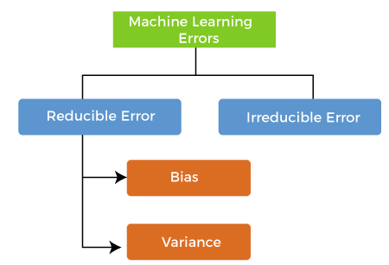
Regularization: Bias and Variance
An error is a measure of how accurately an algorithm can make predictions for the previously unknown dataset.
Reducible errors: These errors can be reduced to improve the model accuracy. Such errors can further be classified into bias and Variance.
Irreducible errors: These errors will always be present in the model

Slide 57
Regularization: Bias and Variance
Bias: a difference between prediction values made by the model and actual values/expected values is known as bias errors or Errors due to bias.
Low Bias: A low bias model will make fewer assumptions about the form of the target function.
High Bias: A model with a high bias makes more assumptions, and the model becomes unable to capture the important features of our dataset. A high bias model also cannot perform well on new data.
Some examples of machine learning algorithms with low bias are Decision Trees, k-Nearest Neighbours and Support Vector Machines.
At the same time, an algorithm with high bias is Linear Regression, Linear Discriminant Analysis and Logistic Regression.

Slide 58
Regularization: Bias and Variance
Ways to reduce High Bias:
Increase the input features as the model is underfitted.
Decrease the regularization term.
Use more complex models, such as including some polynomial features.

Slide 59
Regularization: Bias and Variance
Variance
The variance would specify the amount of variation in the prediction if the different training data was used.
It tells that how much a random variable is different from its expected value.
Ideally, a model should not vary too much from one training dataset to another, which means the algorithm should be good in understanding the hidden mapping between inputs and output variables.
Variance errors are either of low variance or high variance.
Low variance means there is a small variation in the prediction of the target function with changes in the training data set.
At the same time, High variance shows a large variation in the prediction of the target function with changes in the training dataset.

Slide 60
Regularization: Bias and Variance
A model with high variance has the below problems:
A high variance model leads to overfitting.
Increase model complexities.
Ways to Reduce High Variance:
Reduce the input features or number of parameters as a model is overfitted.
Do not use a much complex model.
Increase the training data.
Increase the Regularization term.

Slide 61
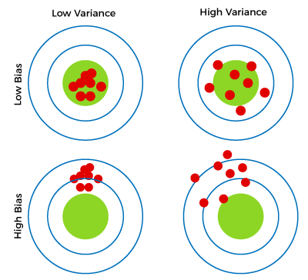
Regularization: Bias and Variance
Different Combinations of Bias-Variance

Slide 62
Regularization: Bias and Variance
Different Combinations of Bias-Variance
Low-Bias, Low-Variance:
The combination of low bias and low variance shows an ideal machine learning model. However, it is not possible practically.
Low-Bias, High-Variance:
With low bias and high variance, model predictions are inconsistent and accurate on average. This case occurs when the model learns with a large number of parameters and hence leads to an overfitting
High-Bias, Low-Variance:
With High bias and low variance, predictions are consistent but inaccurate on average. This case occurs when a model does not learn well with the training dataset or uses few numbers of the parameter. It leads to underfitting problems in the model.
High-Bias, High-Variance:
With high bias and high variance, predictions are inconsistent and also inaccurate on average.

Slide 63
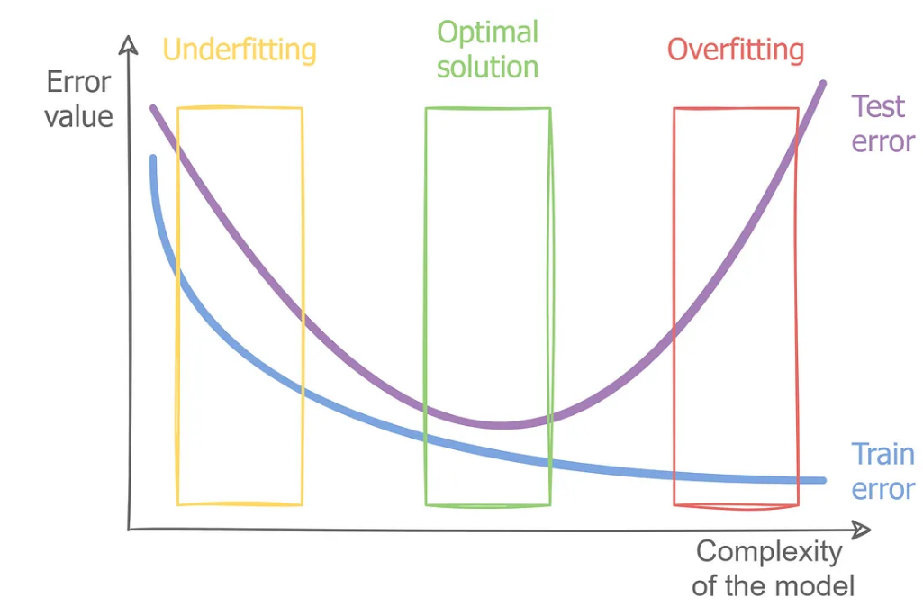
Regularization

Slide 64
Regularization: Overfitting
Overfitting
Overfitting is an undesirable machine learning behavior that occurs when the machine learning model gives accurate predictions for training data but not for new data.
High variance and low bias.
Reasons for Overfiting
The training data size is too small and does not contain enough data samples to accurately represent all possible input data values.
The training data contains large amounts of irrelevant information, called noisy data.
The model trains for too long on a single sample set of data.
The model complexity is high, so it learns the noise within the training data.

Slide 65
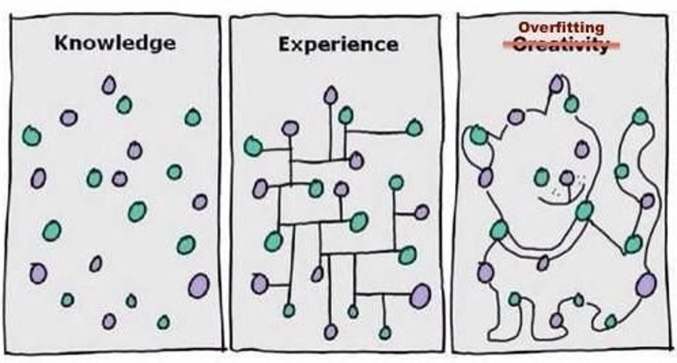
Regularization: Overfitting
Symptom of Overfitting:
Low training error but high validation error.
The model fits the training data very well but fails to generalize to new data.

Slide 66
Regularization: Underfitting
Underfitting
It occurs when a model is too simple to capture data complexities.
It represents the inability of the model to learn the training data effectively result in poor performance both on the training and testing data.
In simple terms, an underfit model’s are inaccurate, especially when applied to new, unseen examples.
It mainly happens when we uses very simple model with overly simplified assumptions.
To address underfitting problem of the model, we need to use more complex models, with enhanced feature representation, and less regularization.
The underfitting model has High bias and low variance.

Slide 67
Regularization: Underfitting
Reasons for Underfitting
The model is too simple, So it may be not capable to represent the complexities in the data.
The input features which is used to train the model is not the adequate representations of underlying factors influencing the target variable.
The size of the training dataset used is not enough.
Excessive regularization are used to prevent the overfitting, which constraint the model to capture the data well.
Features are not scaled.

Slide 68
Regularization: Underfitting
Techniques to Reduce Underfitting
Increase model complexity.
Increase the number of features, performing feature engineering.
Remove noise from the data.
Increase the number of epochs or increase the duration of training to get better results.
Symptoms:
High training error and high validation error.
The model does not fit the training data well, leading to poor predictions even on known data.

Slide 69
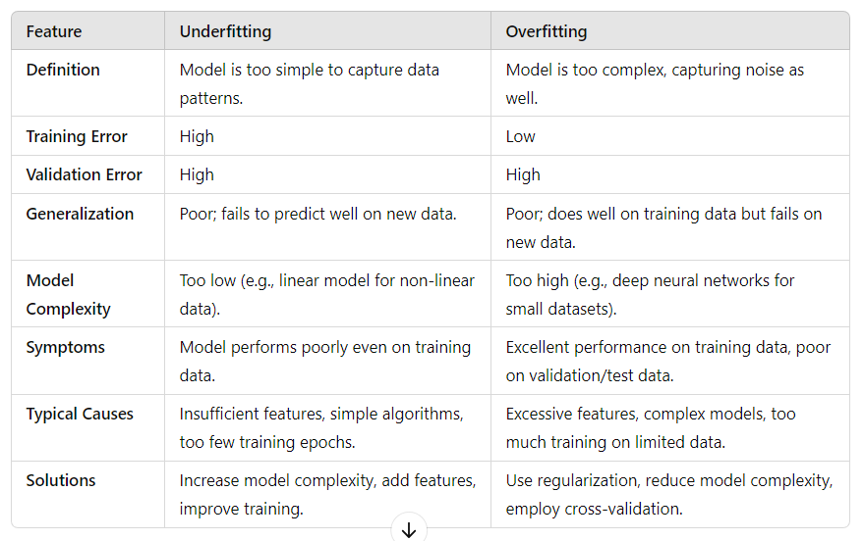
Regularization: Underfitting vs. Overfitting

Slide 70
Regularization: L1 (Lasso)
LASSO (Least Absolute Shrinkage and Selection Operator) is a regression analysis method that incorporates L1 regularization.
It's particularly useful for models that can benefit from feature selection and addressing multicollinearity.

Slide 71
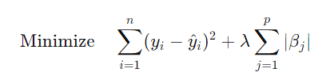
Key Components of L1 (Lasso)
L1 Regularization: LASSO adds a penalty equal to the absolute value of the coefficients multiplied by a tuning parameter (λ) to the loss function. The objective function becomes:
Feature Selection: LASSO tends to shrink some coefficients to exactly zero when the tuning parameter λ is sufficiently large. This means it effectively selects a simpler model by excluding some features, which can improve interpretability.

Slide 72
Key Components of L1 (Lasso)
Bias-Variance Tradeoff: By introducing the penalty, LASSO can help reduce overfitting, making the model more generalizable to unseen data. However, this can introduce some bias.
Tuning Parameter (λ): The choice of λ is crucial. A smaller λ leads to a model closer to ordinary least squares (OLS), while a larger λ increases the amount of shrinkage and feature selection. Techniques like cross-validation are commonly used to find an optimal λ.
Applications: LASSO is widely used in scenarios with many predictors, especially when some of them might be irrelevant or redundant. It's popular in fields like genetics, finance, and machine learning.

Slide 73
Example of L1 (Lasso)
Example Scenario
Imagine you have a dataset with information about houses, and you want to predict the price based on various features:
Features
Size (square feet)
Number of bedrooms
Age of the house
Number of bathrooms
Proximity to downtown
Garage size

Slide 74
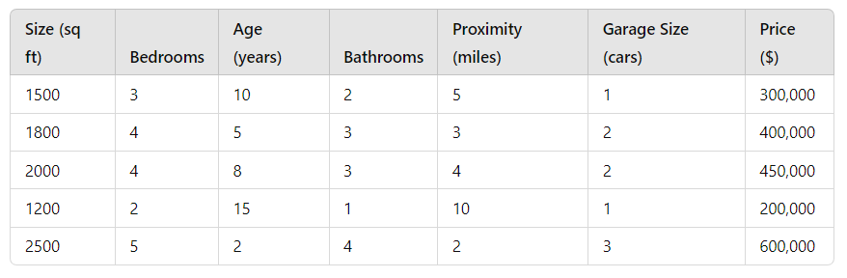
Example of L1 (Lasso)
Dataset
https://colab.research.google.com/drive/1jeqwzMN5hpfasIFu6J9vub0BSBfonQEm#scrollTo=Dw5LvNSEy0nY

Slide 75
Regularization: L1 (Lasso)
https://colab.research.google.com/drive/1pD_uCPkmYla71GerEoN56izmX_ubaol0#scrollTo=3LMS-djesEHk

Slide 76
Regularization: L2 (Ridge)
It is a machine learning technique that avoids overfitting by introducing a penalty term into the model's loss function based on the squares of the model's parameters.
The goal of L2 regularization is to keep the model's parameter sizes short and prevent oversizing.
In order to achieve L2 regularization, a term that is proportionate to the squares of the model's parameters is added to the loss function.
This word works as a limiter on the parameters' size, preventing them from growing out of control.
A hyperparameter called lambda that controls the regularization's intensity also controls the size of the penalty term.
The parameters will be smaller and the regularization will be stronger the greater the lambda.

Slide 77

Regularization: L2 (Lasso)
A regression model that uses the L2 regularization technique is called Ridge regression.
Ridge regression adds the “squared magnitude” of the coefficient as a penalty term to the loss function(L).

Slide 78
Regularization: L1(Lasso) and L2 (Ridge)
Link for Code:
https://colab.research.google.com/drive/1YkOjpnMJdYWvn0oqjJUCKebbqredDlFH#scrollTo=ityALR23ZF-R
Link for Dataset:
https://www.kaggle.com/anthonypino/melbourne-housing-market

Slide 79
Benefits of Regularization
Reduces Overfitting: Regularization helps prevent models from learning noise and irrelevant details in the training data.
Improves Generalization: By discouraging complex models, regularization ensures better performance on unseen data.
Enhances Stability: Regularization stabilizes model training by penalizing large weights.
Enables Feature Selection: L1 regularization can zero out some coefficients, effectively selecting more relevant features.
Manages Multicollinearity: Reduces the problem of high correlations among features, particularly useful in linear models.

Slide 80
Benefits of Regularization
Encourages Simplicity: Promotes simpler models that are easier to interpret and less likely to overfit.
Controls Model Complexity: Provides a mechanism to balance the complexity of the model with its performance on the training and test data.
Facilitates Robustness: Makes models less sensitive to individual peculiarities in the training set.
Improves Convergence: Helps optimization algorithms converge more quickly and reliably by smoothing the error landscape.
Adjustable Complexity: The strength of regularization can be tuned to fit the data's specific needs and desired model complexity.

Slide 81
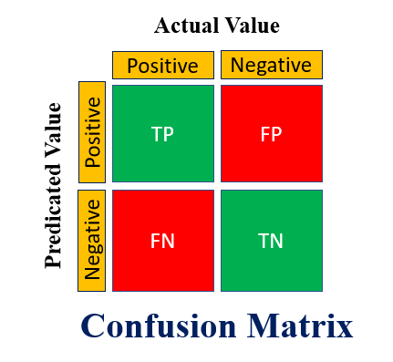
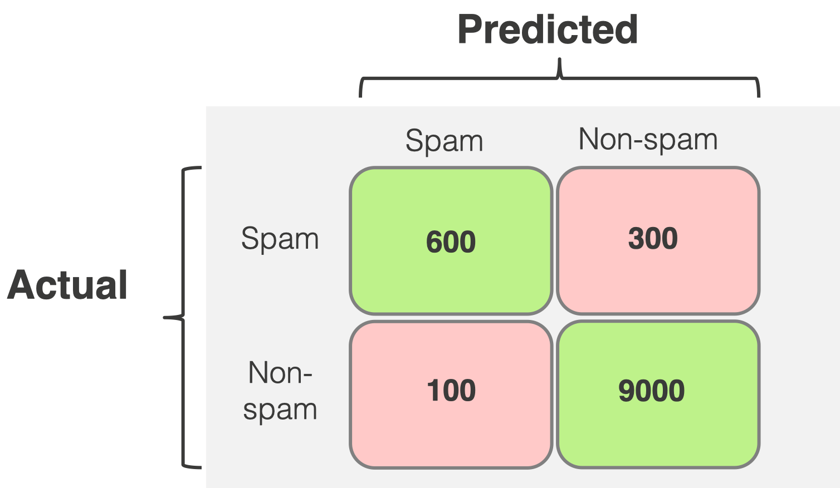
Confusion Matrix
A confusion matrix is a tool used in machine learning to evaluate the performance of a classification model.
It provides a visual representation of the actual versus predicted classifications, helping to understand the types of errors made by the model.

Slide 82
Confusion Matrix
True Positive (TP): The number of correct predictions that an instance is positive.
True Negative (TN): The number of correct predictions that an instance is negative.
False Positive (FP): The number of incorrect predictions where an instance is predicted as positive, but it is actually negative (Type I error).
False Negative (FN): The number of incorrect predictions where an instance is predicted as negative, but it is actually positive (Type II error).

Slide 83
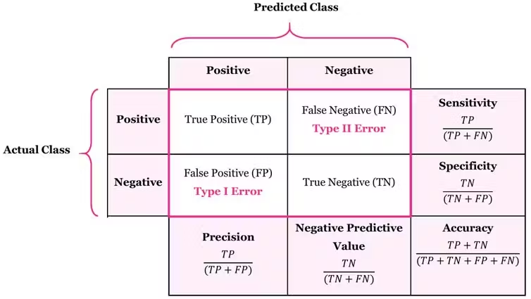
Confusion Matrix

Slide 84
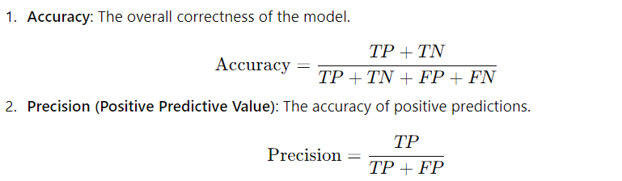
Key Metrics Derived from the Confusion Matrix

Slide 85
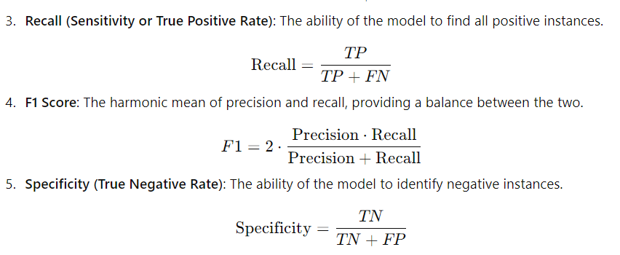
Key Metrics Derived from the Confusion Matrix

Slide 86
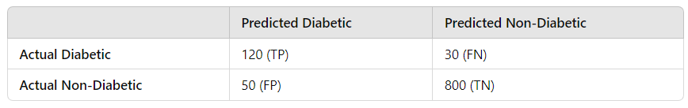
Case Study: Medical Diagnosis for Diabetes
Context: A healthcare provider develops a machine learning model to predict whether patients have diabetes based on various health metrics. After training and validating the model, they evaluate its performance using a confusion matrix.
Data Overview
The model was tested on a dataset of 1,000 patients, with the following results:
Actual Diabetic Patients: 150
Actual Non-Diabetic Patients: 850
Confusion Matrix

Slide 87
Case Study: Medical Diagnosis for Diabetes
Interpretation of the Confusion Matrix
True Positives (TP): 120 patients were correctly identified as diabetic.
False Negatives (FN): 30 patients were diabetic but were incorrectly classified as non-diabetic.
False Positives (FP): 50 patients were classified as diabetic, but they were actually non-diabetic.
True Negatives (TN): 800 patients were correctly identified as non-diabetic

Slide 88
Case Study: Medical Diagnosis for Diabetes
Interpretation of the Confusion Matrix
True Positives (TP): 120 patients were correctly identified as diabetic.
False Negatives (FN): 30 patients were diabetic but were incorrectly classified as non-diabetic.
False Positives (FP): 50 patients were classified as diabetic, but they were actually non-diabetic.
True Negatives (TN): 800 patients were correctly identified as non-diabetic

Slide 89
Case Study: Medical Diagnosis for Diabetes
Key Metrics
Accuracy = 92%
Precision = 70.6%
Recall = 80%
F1-Score = 75%
Insights and Analysis
High Accuracy: The model has a high accuracy of 92%, which might seem promising, but accuracy alone does not give a complete picture, especially in medical diagnosis where the costs of false negatives can be significant.
Precision vs. Recall: With a precision of 70.6%, the model does reasonably well when it predicts diabetes. However, a recall of 80% indicates that some diabetic patients are being missed, which can be critical in healthcare settings.
Focus on Recall: Given that missing a diabetic patient can lead to serious health complications, healthcare providers might prioritize improving recall, even if it results in a lower precision (increased false positives).

Slide 90

K-fold cross-validation

Slide 91
K-fold cross-validation
Data Partitioning: K-fold cross-validation divides the dataset into k equal-sized subsets (or "folds"), allowing the model to be trained and validated multiple times. Each fold serves as the validation set once while the remaining folds are used for training.
Performance Estimation: The model is trained and evaluated k times, and the performance metrics (like accuracy, precision, recall, etc.) are averaged across all folds. This provides a more reliable estimate of the model's performance on unseen data.
Mitigation of Overfitting: By using multiple train-test splits, k-fold cross-validation helps reduce overfitting, ensuring that the model generalizes well to new data rather than just memorizing the training set.

Slide 92
K-fold cross-validation
Flexibility in Choice of k: The value of k can be adjusted based on the size of the dataset and the computational resources available. Common choices are k = 5 or k = 10, but smaller or larger values can be used depending on specific needs.
Stratification Option: In cases of imbalanced datasets, stratified k-fold cross-validation can be employed to ensure that each fold has a similar distribution of classes, which helps maintain the representativeness of each fold.

Slide 93
How K-Fold Cross-Validation Works
Data Splitting:
The entire dataset is randomly divided into k subsets or "folds" of approximately equal size.
Common values for k are 5 or 10, but it can be adjusted based on the size of the dataset.
Model Training and Validation:
The model is trained and validated k times.
In each iteration:
One fold is used as the validation set, while the remaining k-1 folds are used for training.
This process ensures that every instance in the dataset is used for both training and validation at least once.

Slide 94
How K-Fold Cross-Validation Works
Performance Measurement:
After completing all k iterations, the performance metrics (such as accuracy, precision, recall, F1 score, etc.) are averaged across all iterations.
This average provides a more comprehensive view of the model's performance.

Slide 95
Disadvantages of K-Fold Cross-Validation
Better Generalization: By using multiple train-test splits, k-fold cross-validation reduces the risk of overfitting and provides a better estimate of how the model will perform on unseen data.
Efficient Use of Data: Since each instance in the dataset is used for both training and validation, it maximizes the utilization of available data, which is particularly important for smaller datasets.
Variance Reduction: Averaging the results over multiple folds helps to smooth out the variability that can occur with a single train-test split.

Slide 96
Advantages of K-Fold Cross-Validation
Computationally Intensive: K-fold cross-validation can be computationally expensive, especially for large datasets or complex models, as the model must be trained k times.
Choice of K: Selecting an appropriate value for k is crucial. A very small k may lead to high variance in the performance estimate, while a very large k can be computationally expensive.

Slide 97
Regularization
Regularization: Bias and Variance, Overfitting and Underfitting, L1 and L2 Regularization, Regularized Linear Regression, Decision Trees (ID3, C4.5, CART), Confusion matrix, k-folds cross-validation, K Nearest Neighbour, Support vector machine.

Slide 98
QUIZ
The Mean Square Error (MSE) is used to measure:
a) The percentage of correctly classified samples
b) The average squared difference between predicted and actual values
c) The strength of the relationship between features
d) The accuracy of a classification model
R-squared is a metric that:
a) Measures the error in a classification task
b) Indicates the proportion of variance explained by a regression model
c) Measures the distance between clusters in unsupervised learning
d) Compares different regularization techniques

Slide 99
QUIZ
Agents can be grouped into five classes based on their degree of perceived intelligence and i
Which of the following is NOT true about Logistic Regression?
a) It is used for binary classification problems
b) It outputs probabilities for each class
c) It minimizes the Mean Square Error
d) It uses the sigmoid function to predict outcomes
Regularization techniques like L1 and L2 are used to address:
a) Missing data in a dataset
b) Overfitting and underfitting in machine learning models
c) Scaling of features for training
d) Classification tasks

Slide 100
QUIZ
Agents can be grouped into five classes based on their degree of perceived intelligence and i
What is the primary purpose of regression in machine learning?
a) Classify data into categories
b) Predict continuous values
c) Reduce dimensionality of data
d) Group similar data points
Which regression technique is best suited for modeling a dataset where the relationship between variables is non-linear?
a) Univariate Linear Regression
b) Polynomial Regression
c) Multivariate Linear Regression
d) Regularized Regression

Slide 101
QUIZ
Agents can be grouped into five classes based on their degree of perceived intelligence and i
What is the primary purpose of regression in machine learning?
a) Classify data into categories
b) Predict continuous values
c) Reduce dimensionality of data
d) Group similar data points
Which regression technique is best suited for modeling a dataset where the relationship between variables is non-linear?
a) Univariate Linear Regression
b) Polynomial Regression
c) Multivariate Linear Regression
d) Regularized Regression

Slide 102
ASSIGNMENTS
Agents can be grouped into five classes based on their degree of perceived intelligence and i
Explain the difference between univariate, multivariate, and polynomial regression. Provide examples where each type would be applicable.
Write a Python program to implement linear regression using the sklearn library and evaluate it using Mean Square Error (MSE) and R-squared metrics.
Logistic regression is used for classification problems. Explain how the sigmoid function is used in logistic regression and its significance.
Explain the concepts of bias and variance in machine learning. How do they relate to overfitting and underfitting?
Compare L1 (Lasso) and L2 (Ridge) regularization. When would you use each of these techniques? Write Python code to demonstrate regularized linear regression using Ridge regression.
Compare the ID3, C4.5, and CART algorithms for decision trees. Highlight their key differences and use cases.
Use the sklearn library to implement a decision tree classifier on any dataset of your choice. Display the confusion matrix and interpret the results.

Slide 103
References
Agents can be grouped into five classes based on their degree of perceived intelligence and i
Introduction to Statistical Learning, Springer, 2013 By Gareth James, Daniela Witten, Trevor Hastie, Robert Tibshirani.
Pattern Classification, 2nd Ed., John Wiley & Sons, 2001, Richard Duda, Peter Hart, David Stork.
Machine Learning, McGraw Hill International Edition, by Tom.M.Mitchell.
Introduction to Machine Learning, Eastern Economy Edition, Prentice Hall of India, 2005 By Ethern Alpaydin.
Pattern Recognition and Machine Learning. Berlin: Springer-Verlag., Bishop, C.

